Slide 1
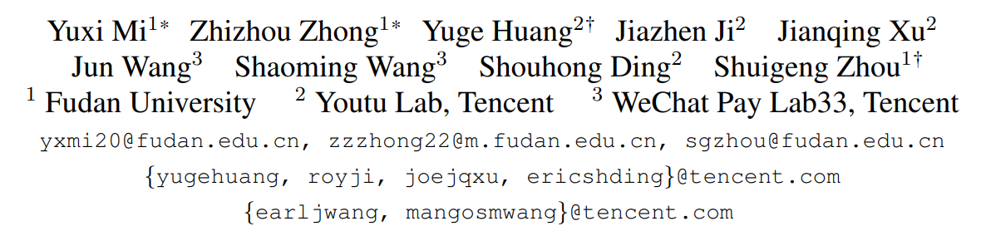
Privacy-Preserving Face Recognition Using Trainable Feature Subtraction
Shannon Henry, Le Quoc Cu
Ali Raza, Yakhyokhuja

Slide 2





Introduction
Why privacy-preserving face recognition?
Privacy leakage
Client / Camera
Face image
Internet
FR service
Face recognition is widely used in online services.
Face images are sensitive biometric data.
Clients may need to send face images to remote servers.
Unauthorized access can expose identity and facial appearance.
Goal of PPFR: identify a person without directly exposing the original face image.
Notes:
[~50 s]
Face recognition is now widely used in many online services. In a typical system, a client device captures a face image and sends it to a remote server for recognition. However, face images are sensitive biometric data. If these images are intercepted or leaked, they can reveal both personal identity and facial appearance. Therefore, we need face recognition systems that can still identify a person without directly exposing the original face image. This is the goal of privacy-preserving face recognition, or PPFR.

Slide 3
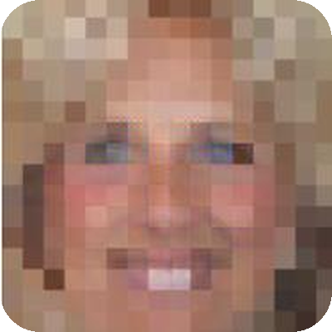


Introduction
The core problem: privacy vs. recognition
Privacy
F( · )
Hide visual appearance and resist recovery attacks.
Utility
Original face X
Privacy-preserving transformation
Protective representation
X_{p} = F(X)
Preserve identity information and maintain recognition accuracy.
Privacy ↑
trade-off
Recognition accuracy ↑
remove more information
keep more information
Challenge: identity features and visual features are closely intertwined.
Notes:
[~60 s]
The goal of PPFR is not only to make the image look different. A good protective representation should satisfy two requirements. First, it should hide the visual appearance of the original face and prevent an attacker from recovering it. Second, it should still preserve enough identity information for accurate face recognition. The main difficulty is that identity features and visual features are closely related. If we remove too much information, recognition accuracy decreases. But if we keep too much information, privacy becomes weak. So the central problem is the trade-off between privacy and recognition accuracy.

Slide 4





Related Work
Existing PPFR approaches: two main families
Cryptographic methods
Transform-based methods
Homomorphic encryption
Noise or image transformation
Secure multi-party computation
Frequency-domain feature removal
Steganography / adversarial perturbation
Strong privacy protection
Lower computation and latency
High computation and latency
Privacy remains challenging
Transform-based methods are practical, but privacy remains challenging.
Notes:
[~60 s]
Previous PPFR methods can mainly be divided into two groups. The first group is cryptographic methods, such as homomorphic encryption and secure multi-party computation. These methods provide strong protection, but they usually require high computational cost and higher latency. The second group is transform-based methods. Instead of encrypting the image, they transform the face into a protective representation. For example, previous studies use noise, frequency-domain feature removal, steganography, or adversarial perturbations. These methods are usually more efficient, but they still face an important privacy problem.

Slide 5
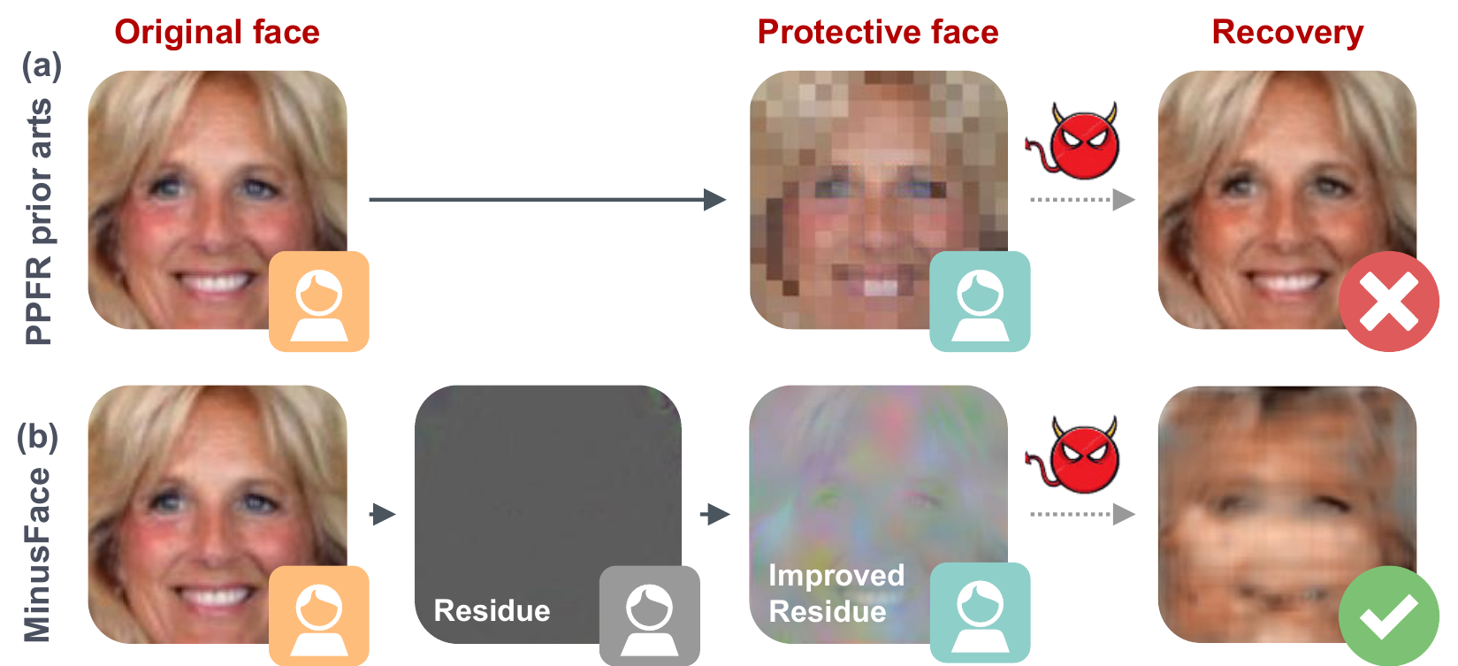
Related Work
Hidden does not mean secure
1
Existing methods remove visually informative features.
2
Some subtle information may still remain.
3
A recovery model can exploit these remaining clues.
4
A face can be visually hidden but still recoverable by a neural network.
Figure 1. (a) prior PPFR arts vs. (b) MinusFace · Mi et al., CVPR 2024
Visually hidden does not always mean secure.
Notes:
[~70 s] (Point to Figure 1, row (a))
This is the key limitation discussed in the paper. Many transform-based methods successfully hide the face from human observers. However, visually hidden does not always mean secure. Small visual or texture clues may still remain inside the protective representation. An attacker can collect protected and original face pairs and train a neural network to reconstruct the original face. Therefore, the problem is not only whether humans can see the face, but also whether a machine learning attacker can recover it. As shown in this figure, previous methods gradually remove visual information, but incomplete removal can still allow successful recovery attacks.

Slide 6
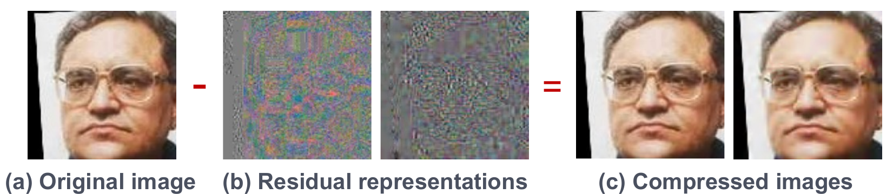

Motivation
Key insight: learning from image compression
Figure 2. Original − residual = compressed image · Mi et al., CVPR 2024
Compression removes subtle texture and color details.
The discarded residue is visually uninformative.
But the residue still contains descriptive information from the original image.
1
2
3
Can we learn a residue that hides appearance but preserves identity?
Notes:
[~70 s] (Point to Figure 2)
The authors approach the problem from a different direction. Their key inspiration comes from image compression. During compression, some subtle information, such as texture details and color variations, is removed. Interestingly, the removed residual information looks almost meaningless to humans, but it still contains some descriptive information about the original image. This observation leads to a new question: instead of manually finding which visual features should be removed, can we learn a residual representation that contains very little visual information but still preserves identity information?

Slide 7

Contributions
MinusFace: main idea and contributions
High-dimensional
representation
Feature
subtraction
Identity-preserving
residue
Random channel
shuffling
Original face
Protective face
1
2
3
Trainable feature subtraction
High-dimensional representation + random channel shuffling
MinusFace framework
Learn a residue between the original face and its regeneration.
Preserve identity while improving privacy.
High recognition accuracy with stronger protection against recovery attacks.
Notes:
[~60 s]
Based on this idea, the authors propose MinusFace. The first contribution is trainable feature subtraction, which learns a residue between the original face and its regenerated version. The second contribution is the use of a high-dimensional representation and random channel shuffling. These techniques are designed to preserve identity information while making recovery more difficult. Finally, the authors combine these components into the complete MinusFace framework and show that it achieves high recognition accuracy together with stronger privacy protection.
Transition: Next, [Name] will explain how MinusFace performs feature subtraction and random channel shuffling.

Slide 8
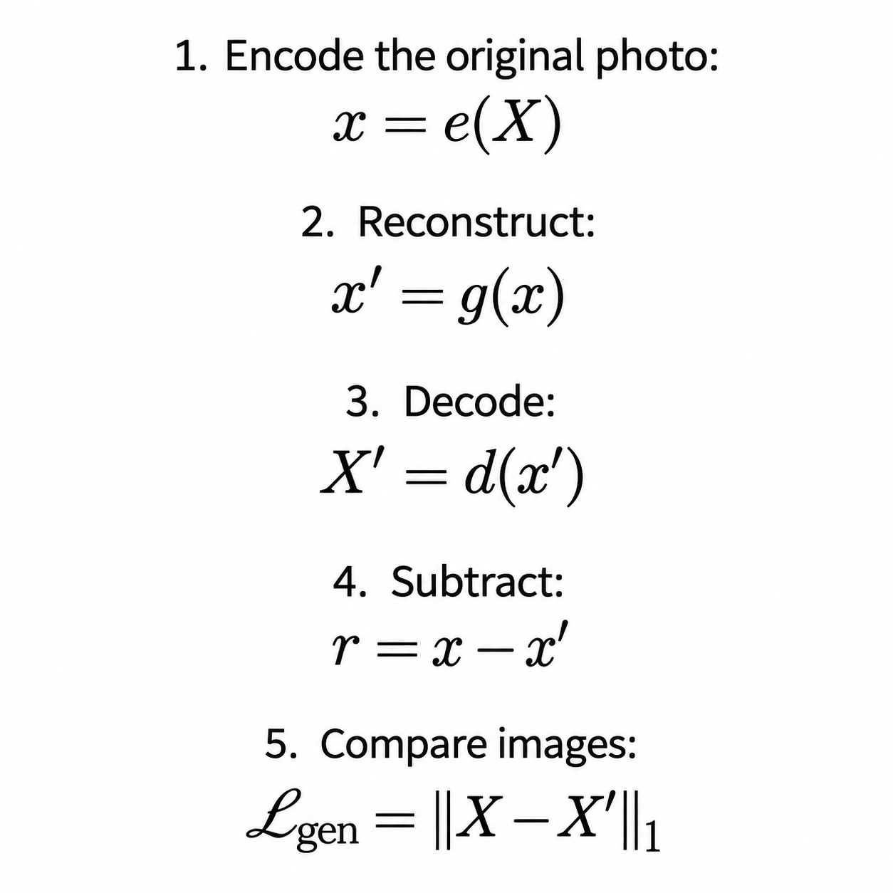
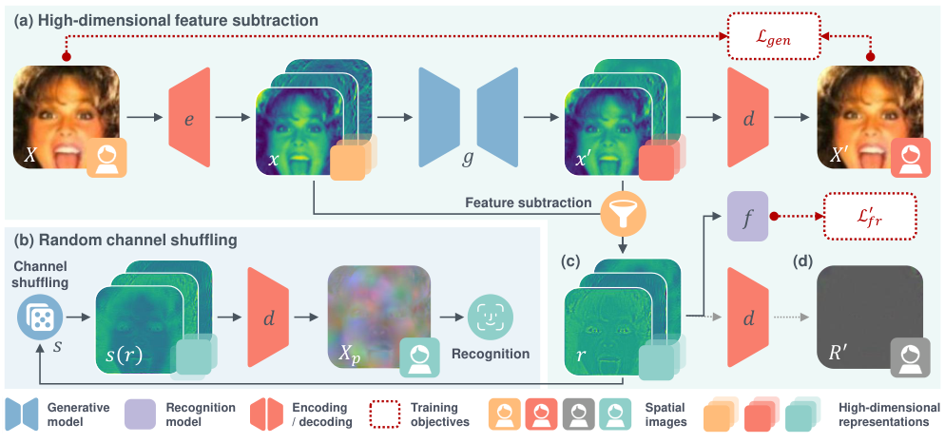
Methodology
Steps 1–5: encoding, reconstruction, and residual
MinusFace · Methodology
1
Notes:
Opening: So we have established that this paper’s main goal is privacy-preserving face recognition. In a conventional service, a device sends a face image to a server. The server extracts an identity template and compares it with enrolled templates, but the image reveals appearance. MinusFace protects it before transmission. Read steps 1–5 briefly, tracing the top row and subtraction in Figure 4. Save detailed explanations for the following slides.
Source: Mi et al., Privacy-Preserving Face Recognition Using Trainable Feature Subtraction, CVPR 2024. https://arxiv.org/pdf/2403.12457. Figures reproduced/cropped under CC BY 4.0. Sections 3.1–3.5; Appendix A.3 and B.1.

Slide 9
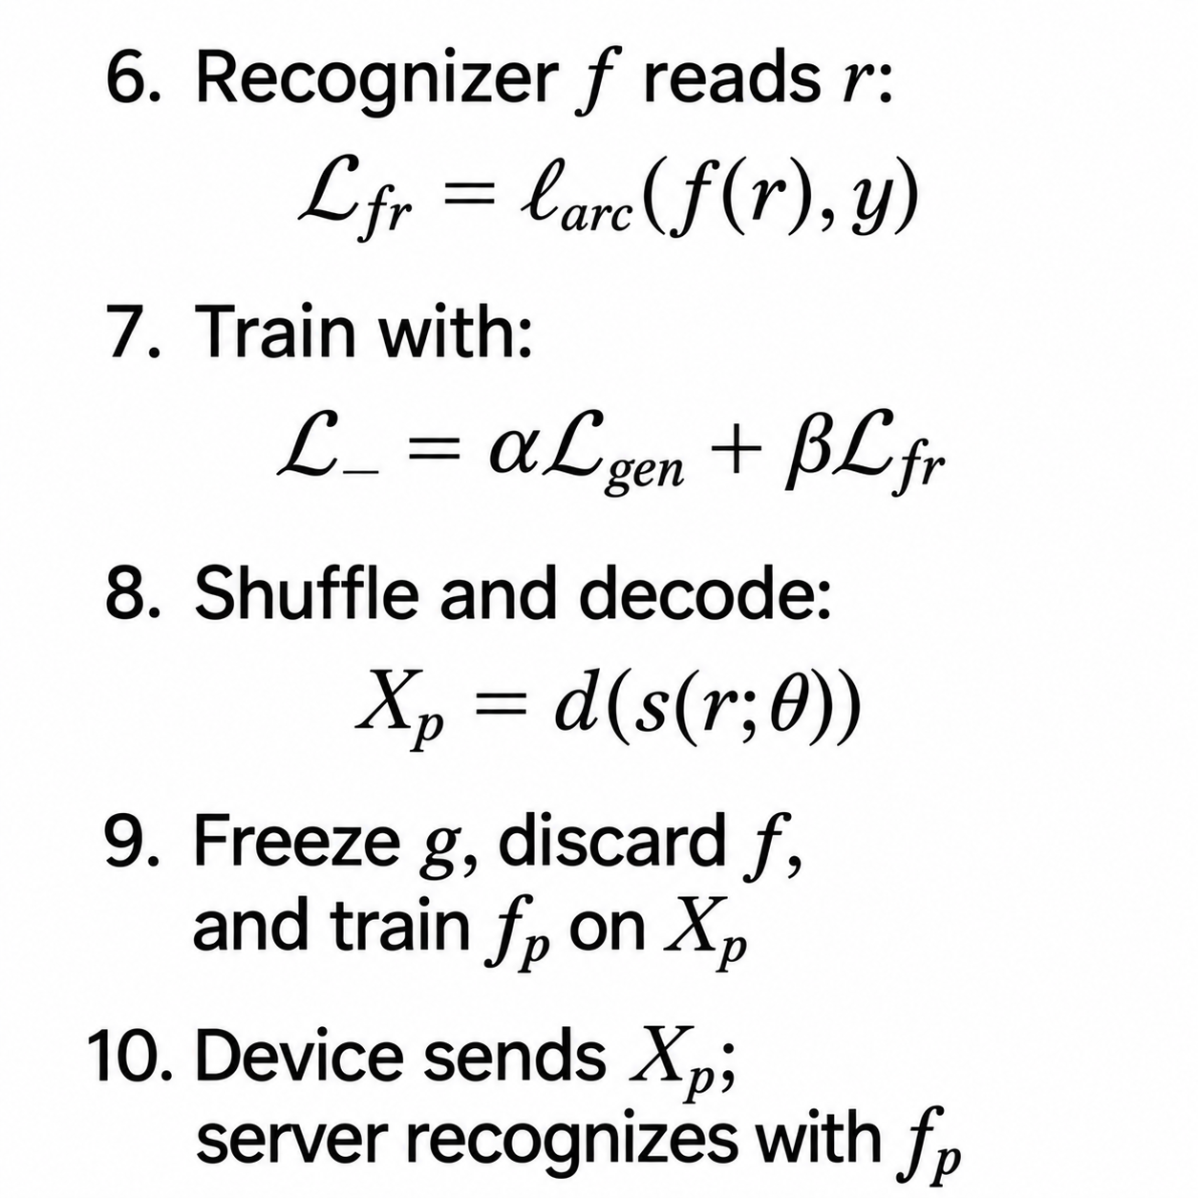
Methodology
Steps 6–10: learning and deployment
Two objectives: close reconstruction and useful identity clues
MinusFace · Methodology
2
Notes:
Read this overview briefly. Six: f reads r, and ArcFace loss uses the correct identity y. Seven: combine reconstruction and recognition losses and train. Eight: shuffle residual channels and decode Xp. Nine: freeze g, discard f, train fp on protected images. Ten: endpoint produces Xp, server recognizes it. The two goals are close reconstructed appearance and identity-informative residuals. Transition: I will now go deeper into the explanation of each step.
Source: Mi et al., Privacy-Preserving Face Recognition Using Trainable Feature Subtraction, CVPR 2024. https://arxiv.org/pdf/2403.12457. Figures reproduced/cropped under CC BY 4.0. Sections 3.1–3.5; Appendix A.3 and B.1.

Slide 10
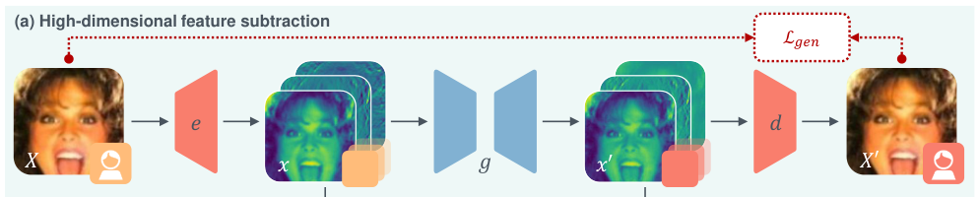
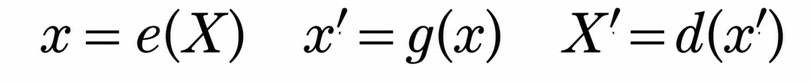
Methodology
Steps 1–3: encode and reconstruct
Why: create a reconstruction whose appearance we can compare with X
MinusFace · Methodology
3
Notes:
Point to X, encoder e, stack x, reconstruction g, x prime, decoder d, X prime. X is the original photo. e is fixed DCT-based encoding into 192 channels. The stack is one image represented numerically. Reduced U-Net g produces x prime. d decodes it to a reconstructed image X prime. Why: the expanded representation supports useful residuals; reconstruction supplies what we subtract; decoding lets us check appearance. DCT does not create new information. Appendix A.3 gives three colour channels times 64 frequencies, with upsampling.
Source: Mi et al., Privacy-Preserving Face Recognition Using Trainable Feature Subtraction, CVPR 2024. https://arxiv.org/pdf/2403.12457. Figures reproduced/cropped under CC BY 4.0. Sections 3.1–3.5; Appendix A.3 and B.1.

Slide 11
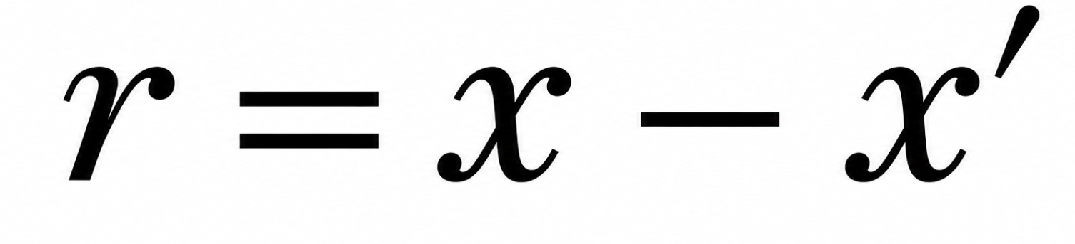
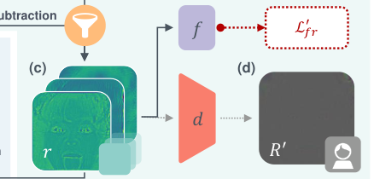
Methodology
Step 4: subtraction and the residual
Residual r: 192-channel differences
R′ = d(r) = X − X′
Encoded identity clues can remain while decoded appearance is nearly blank
Why: retain useful recognition information in the leftover
MinusFace · Methodology
4
Notes:
Point to branches from x and x prime into subtraction, then r in Figure 4(c). r is a full array of leftover differences, not a loss score. Toy example [100,80,60] minus [97,82,60] leaves [3,-2,0]. Why: this residual is trained to carry identity clues and becomes the basis of the protected output. Point to d and dark R prime. d(r) equals X minus X prime; it is nearly blank. Appendix B.1 explains that model-generated expanded arrays can decode to similar images while retaining different channel information. If all r were zero, the recognizer would receive identical inputs for all people.
Source: Mi et al., Privacy-Preserving Face Recognition Using Trainable Feature Subtraction, CVPR 2024. https://arxiv.org/pdf/2403.12457. Figures reproduced/cropped under CC BY 4.0. Sections 3.1–3.5; Appendix A.3 and B.1.

Slide 12
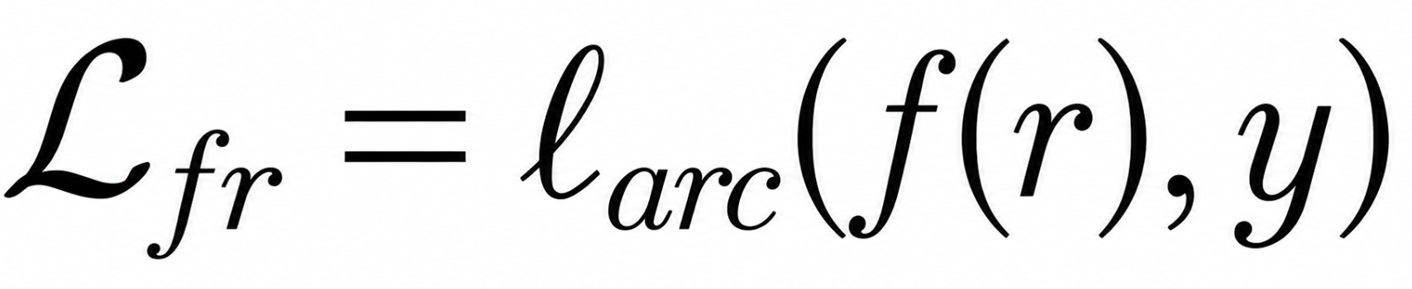
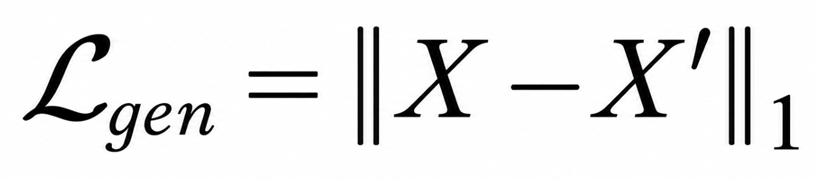
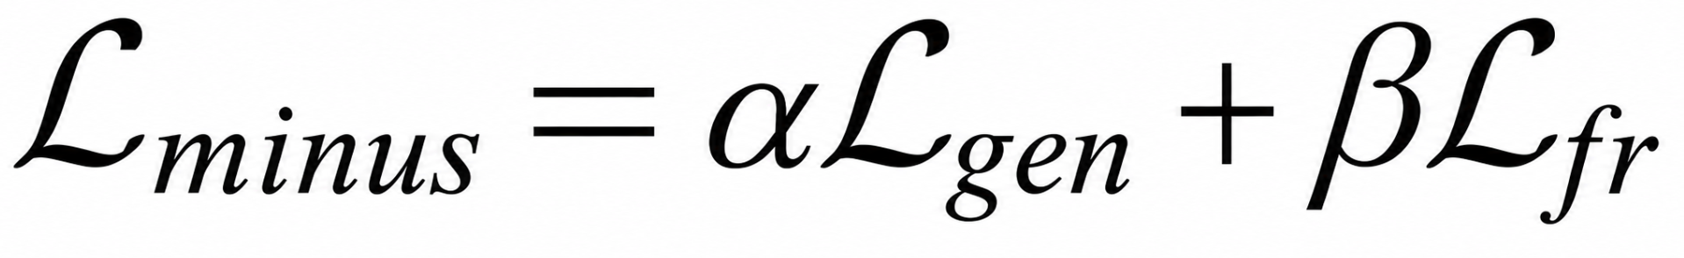
Methodology
Steps 5–7: the training objectives
Reconstruction
Recognition
A close copy reduces
visible image differences
Correct label y trains
identity clues in r
Why: backpropagation balances both objectives
MinusFace · Methodology
5
Notes:
Point to X and X prime in Figure 4, then Lgen. Reconstruction sums absolute image differences. For [3,-2,0], the L1 score is five, which is an illustrative error rather than a target. Then point to r, f, Lfr: ArcFace evaluates identity features against correct y. y checks the answer rather than entering f as a hint. Alpha and beta weight objectives. Appendix uses alpha five and beta one. Backpropagation updates g from both and f from recognition. Fixed e and d transmit gradients but do not learn. Why: reconstruction alone can remove identity clues; recognition alone does not ensure concealed decoded appearance.
Source: Mi et al., Privacy-Preserving Face Recognition Using Trainable Feature Subtraction, CVPR 2024. https://arxiv.org/pdf/2403.12457. Figures reproduced/cropped under CC BY 4.0. Sections 3.1–3.5; Appendix A.3 and B.1.

Slide 13
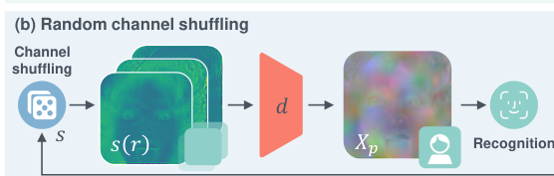
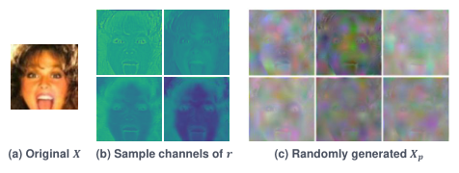
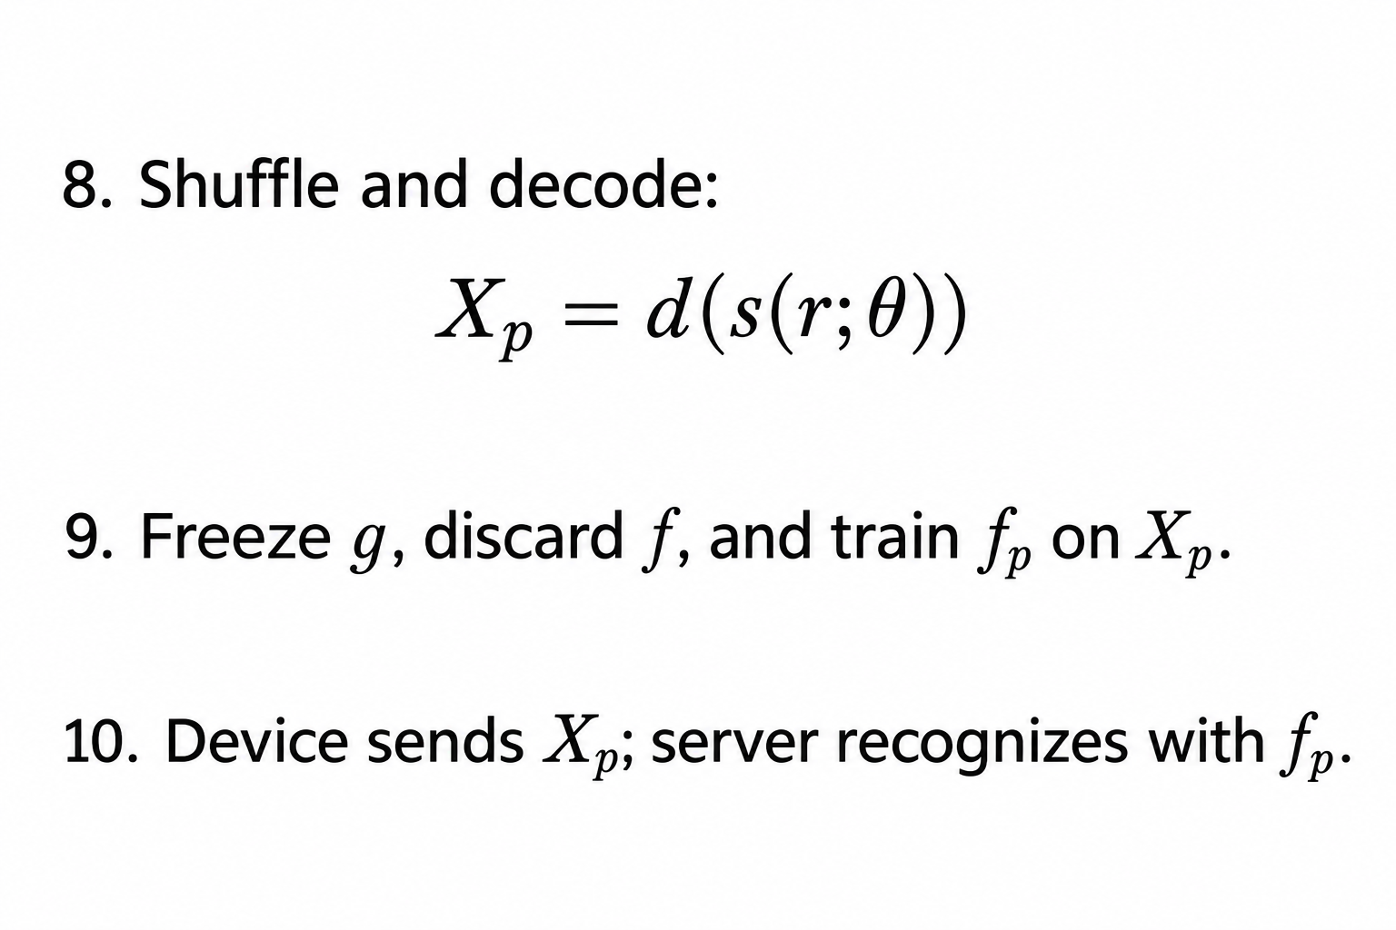
Methodology
Step 8: random channel shuffling
Figure 4(b): shuffle and decode
Figure 5: varied protected outputs
Why: disrupt exposed texture and vary the protected appearance
MinusFace · Methodology
6
Notes:
Figure 4(b): point to shuffle, reordered stack, d, Xp. Individual residual channels may expose subtle facial information. Reorder entire channels rather than pixels or identity predictions. Theta sets a sample-wise random order. Decoder combines them into protected image Xp. Figure 5(a) is one original; (b) shows residual channels; (c) shows different protected images from different shuffles. Toy channel order A-B-C becomes C-A-B while each channel retains contents. Why: obscure textures and randomize appearance while supporting recognition. Recognition accuracy and recovery resistance are evaluated experimentally; 192 factorial permutations alone are not a security proof.
Source: Mi et al., Privacy-Preserving Face Recognition Using Trainable Feature Subtraction, CVPR 2024. https://arxiv.org/pdf/2403.12457. Figures reproduced/cropped under CC BY 4.0. Sections 3.1–3.5; Appendix A.3 and B.1.

Slide 14
Methodology
Steps 9–10: final recognition and deployment
Training
Learn g and f jointly
Deployment:
Freeze g and discard f
Device and server use
Device creates and sends Xp
Server recognizes using fp
Why: protect the photo before it leaves the endpoint device
MinusFace · Methodology
7
Notes:
Point to full Figure 4, then training and use labels. First jointly learn g and f. Freeze g and discard training f. Then train fp on protected images, with three shuffle variants per original in the appendix. f reads 192-channel r; fp reads ordinary protected image Xp. Why: final server model must learn the input it actually receives. During use, device performs encoding, g reconstruction, subtraction, shuffle and decoding before transmitting Xp. Server fp extracts identity features and matches templates. No retraining g for each submission, and no reconstruction of the clear original is required.
Source: Mi et al., Privacy-Preserving Face Recognition Using Trainable Feature Subtraction, CVPR 2024. https://arxiv.org/pdf/2403.12457. Figures reproduced/cropped under CC BY 4.0. Sections 3.1–3.5; Appendix A.3 and B.1.

Slide 15
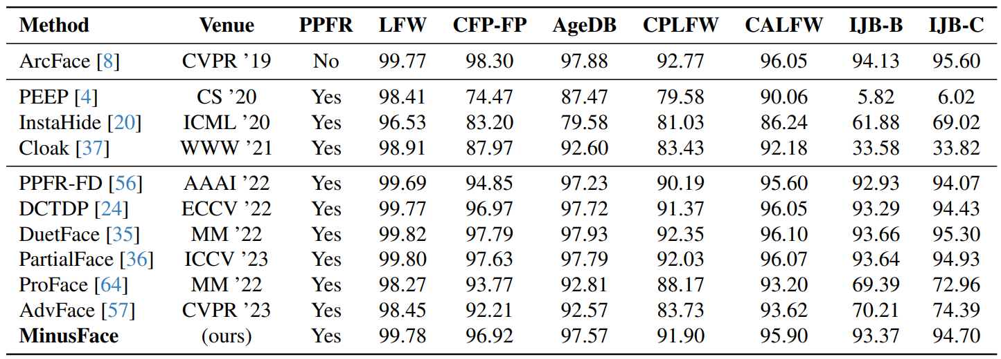
Experiments
Table: The performance comparison among MinusFace, an unprotected baseline, and PPFR SOTAs on face verification and identification tasks.
*Privacy-Preserving Face Recognition(PPFR), Datasets: Labeled Faces in the Wild(LFW), Celebrities in Frontal-Profile(CFP-FP), Cross-Pose(CPLFW), Cross-Age(CALFW), IARPA Janus Benchmark(IJB-B), Metric: Accuracy

Slide 16
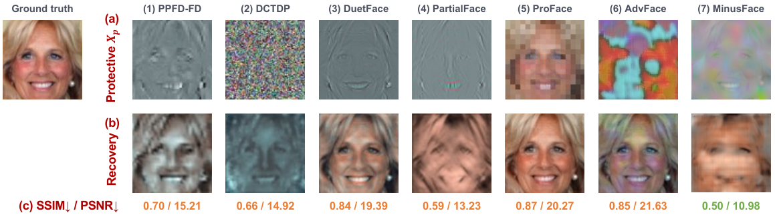
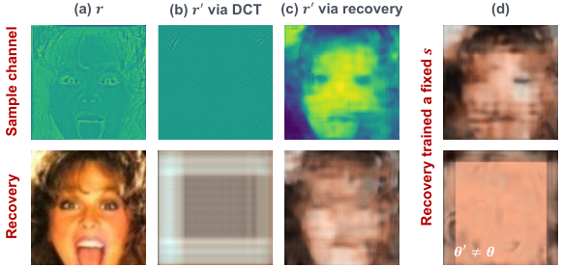
Experiments
Figure: Privacy protection of MinusFace, compared with SOTAs.
*SSIM: Structural Similarity Index Measure, PSNR: Peak Signal-to-Noise Ratio
Figure: MinusFace protection against dedicated attacks.
*r: high-dimensional feature residue, r’: re-encoding of r, DCT: Discrete Cosine Transform
If attacker understands MinusFace's full algorithm, they cannot invert the high-dimensional feature channels (192) or guess the random shuffling seed.

Slide 17
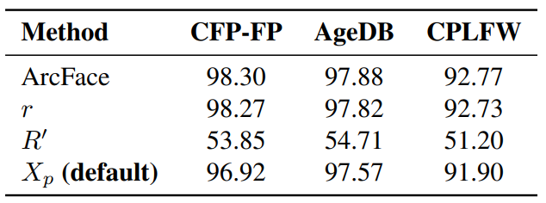
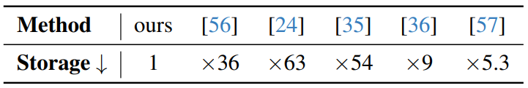
Ablation Study
Why Is MinusFace Considered Better?
MinusFace achieves similar face verification accuracy as SOTA models, even low.
Not a Privacy-Preserving Face Recognition
Claims:
>Completely Defeating Face Recovery Attacks
>Requiring up to 36× to 63× less Storage & Bandwidth than frequency methods
Table: Accuracy of models trained alternatively on r and R'.
Table: Comparison of storage and transmission cost.

Slide 18
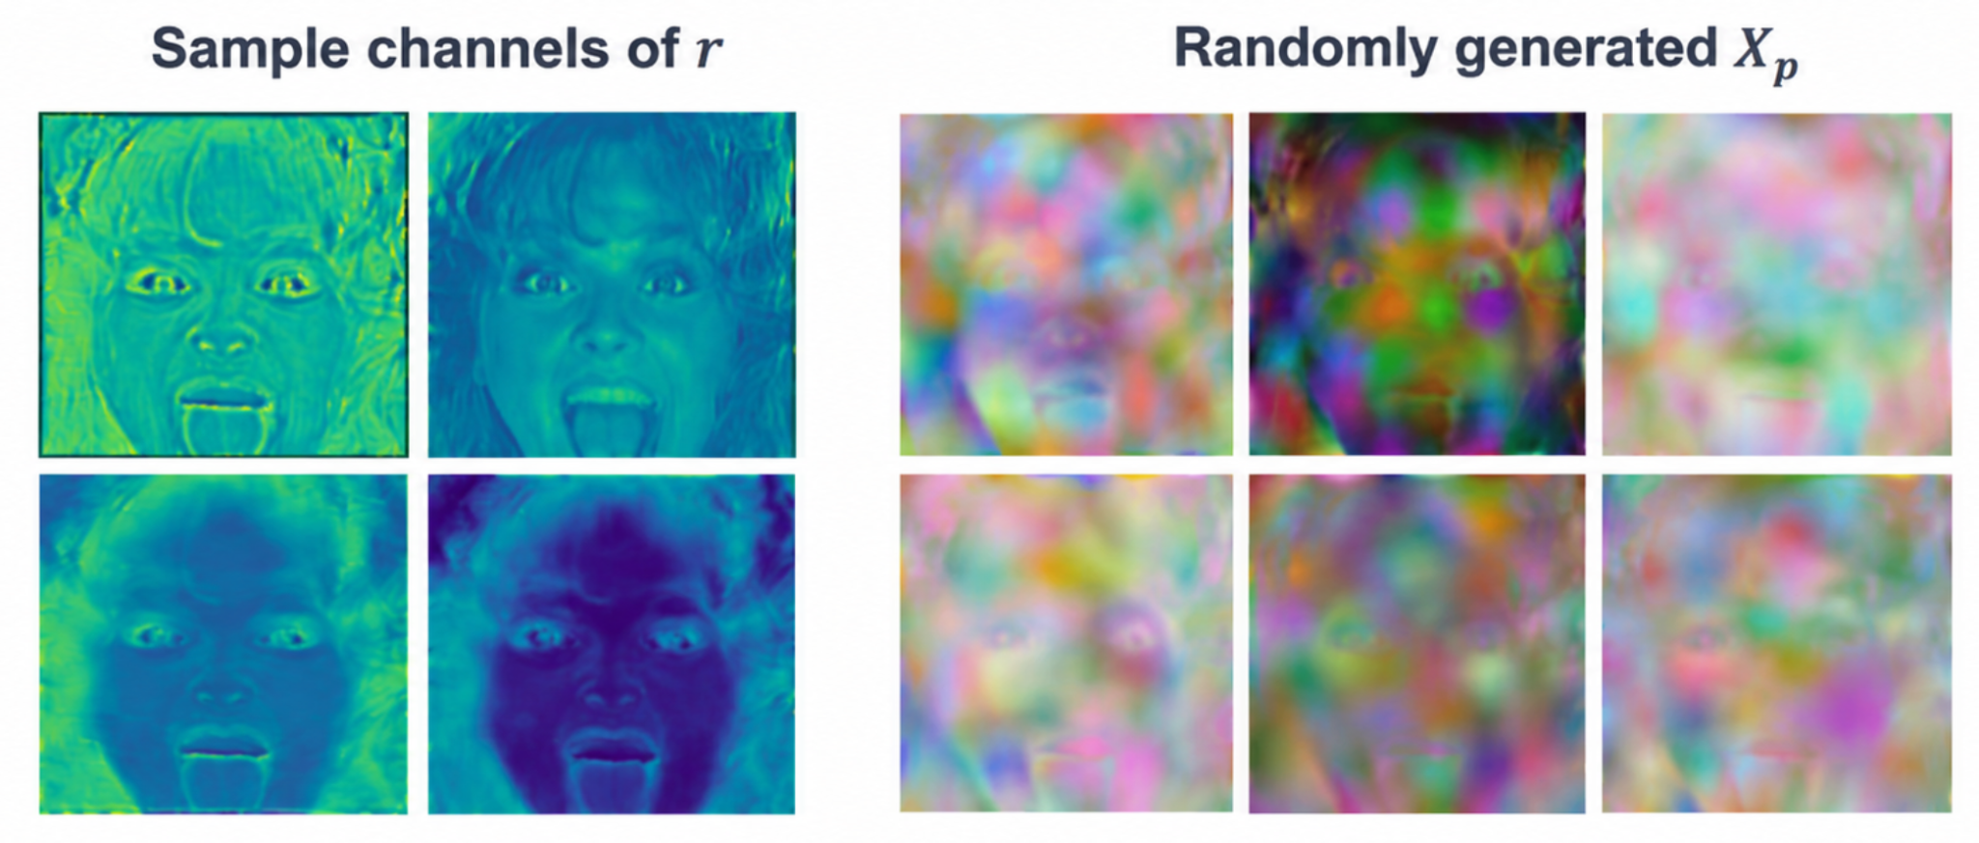
Limitations
Raw residual alone is not sufficiently privacy-preserving
Some visual information may still remain after feature subtraction.
Random channel shuffling is needed to strengthen privacy
The 192 residual channels are randomly permuted to further obscure the remaining visual information.

Slide 19
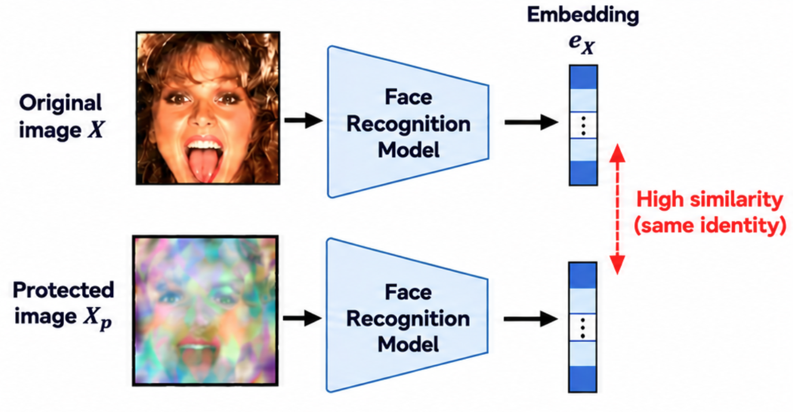
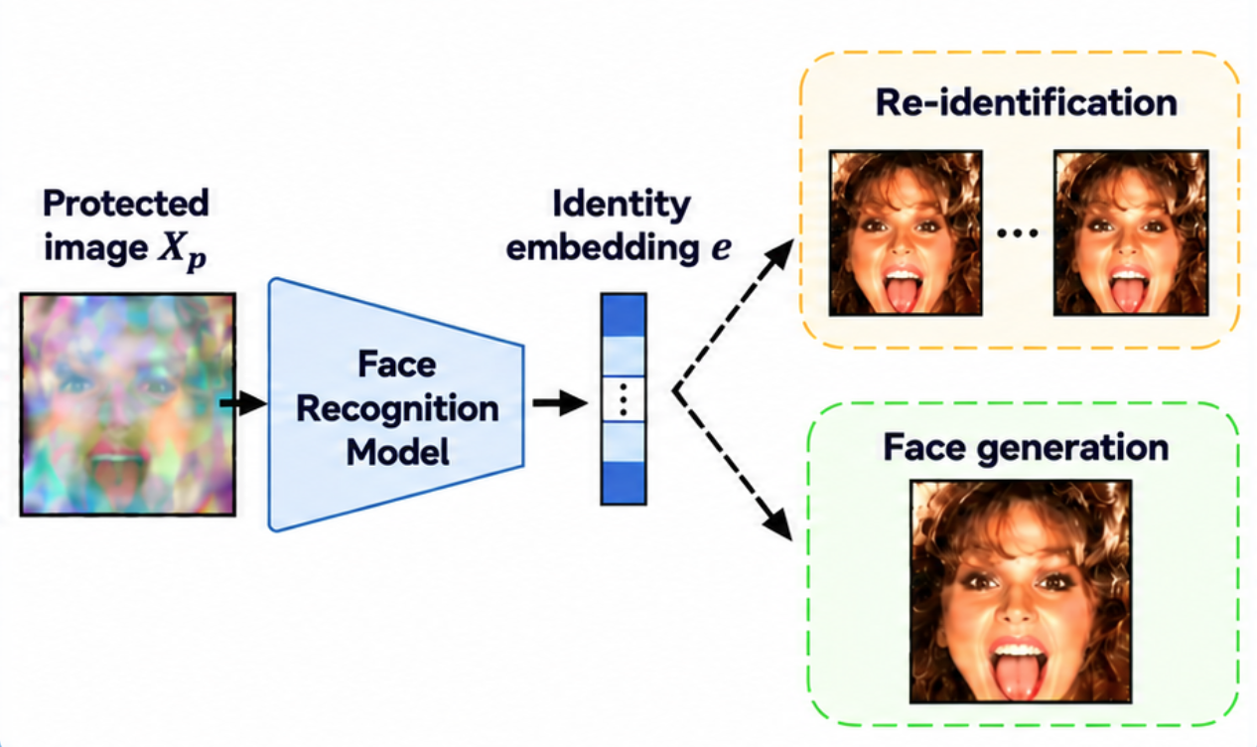
Limitations
Cross-domain identity matching is not evaluated
Original and protected face embeddings may be linkable, but this not evaluated
Embedding-level privacy is not evaluated
Embeddings may still enable re-identification or face generation.
*generated images
Notes:
Embedding privacy is not evaluated
The paper mainly evaluates visual privacy and reconstruction attacks.
It does not study whether the identity embedding itself leaks sensitive identity information.
An exposed embedding could potentially be used for re-identification, tracking, or face generation.

Slide 20
Conclusions
MinusFace introduces trainable feature subtraction for privacy-preserving face recognition.
It reconstructs the face features and subtracts original face features to remove most visible facial information.
High-dim DCT features help preserve identity information.
Random shuffling hides the residual information
MinusFace can maintain recognition performance close to the standard face recognition while making the face reconstruction more difficult.
Main takeaway: MinusFace protects facial appearance, while still intentionally preserving identity information for recognition.

